Slide 1


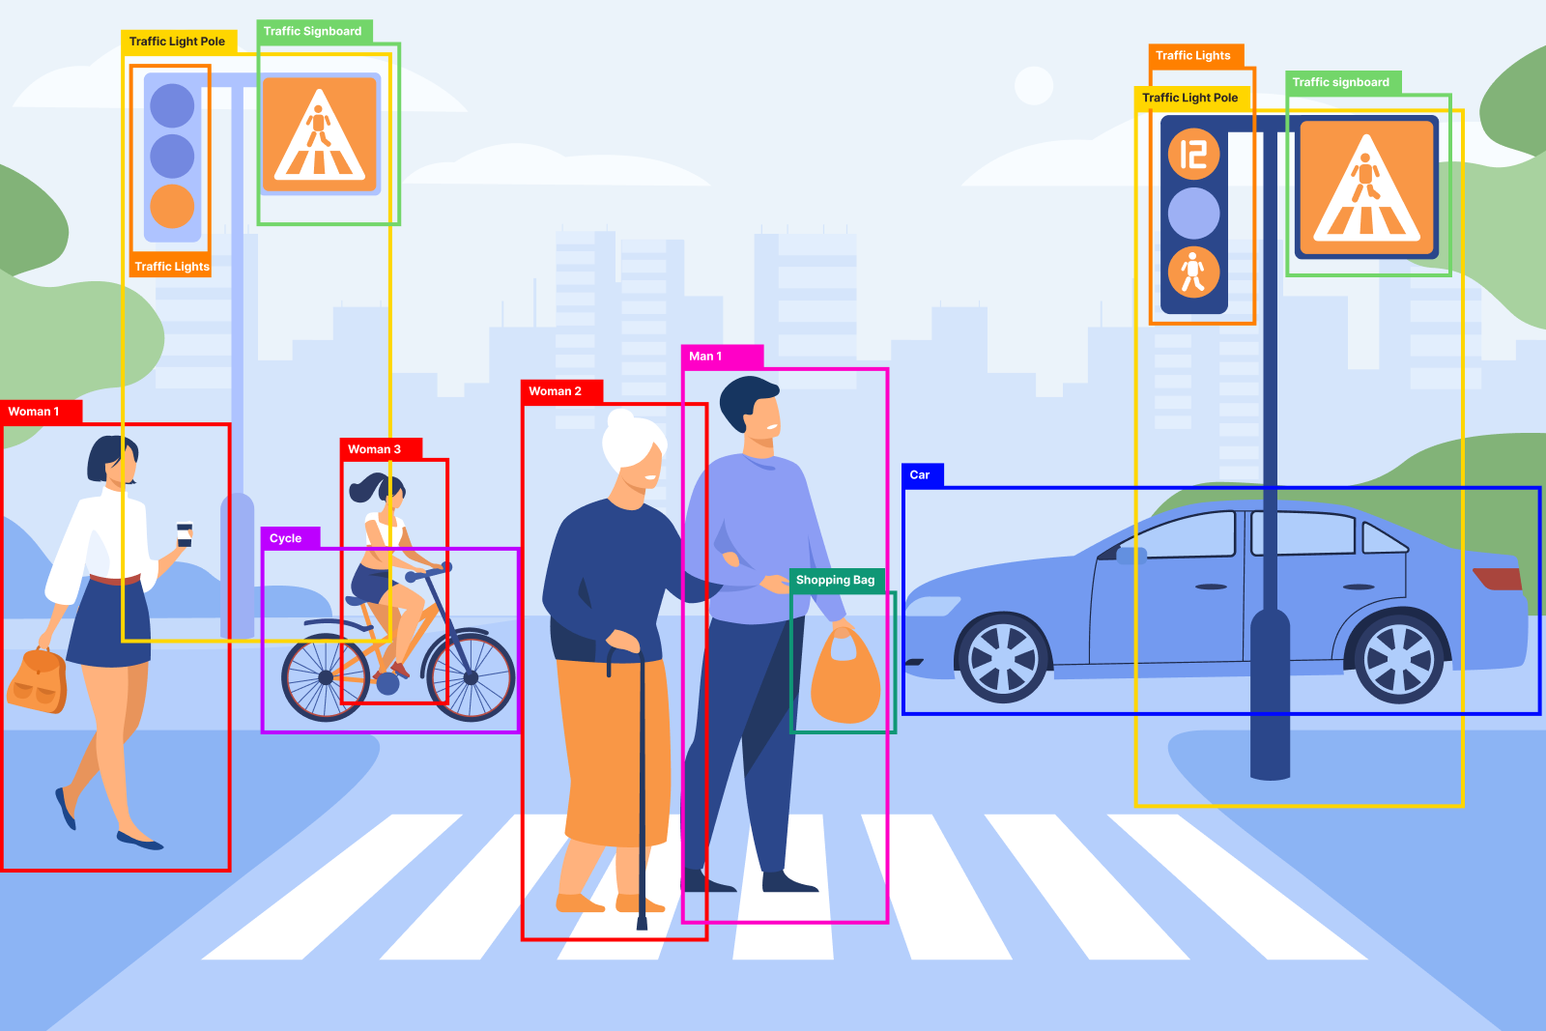

OBJECT DETECTION
Using YOLO Model

Slide 2
TABLE OF CONTENTS
S.NO | CONTENT
1 | INTRODUCTION
2 | PROJECT OVERVIEW
3 | OVERVIEW DIAGRAM
4 | DATASET FINALIZATION
5 | EXPLORATORY DATA ANALYSIS
6 | YOLO CONVERSION
7 | TRAINING THE MODEL
8 | RESULTS AND PERFORMANCE METRICS
9 | CHALLENGES
10 | FUTURE SCOPE

Slide 3

Purpose:
This project aims to develop an advanced object detection and segmentation system leveraging state-of-the-art AI techniques.
Goal:
Transform input images into actionable insights by identifying and delineating objects with precision.
Approach:
Combines deep learning models (YOLO), inference pipelines, and an interactive Streamlit interface for real-time visualization.
Significance:
Enables applications in automation, surveillance, and user-friendly data interaction.
Outcome:
A robust system capable of detecting and segmenting objects in diverse scenarios using the COCO 2017 dataset.
INTRODUCTION

Slide 4


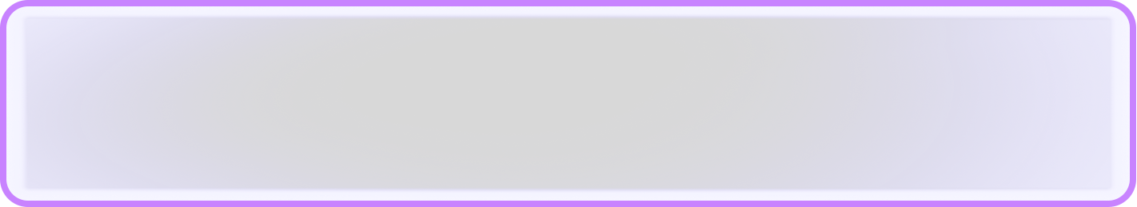
PROJECT OVERVIEW
Context: Object detection and segmentation are pivotal in computer vision, bridging raw data to meaningful interpretations.
Technology Stack: YOLO: Real-time object detection and segmentation model.
Inference: Optimized model deployment for performance.
Streamlit: Web-based interface for interactive results.
Key Features: High accuracy in object localization and boundary delineation.
Scalable implementation for real-world use cases.
Tools Used: YOLO (You Only Look Once), Python, Streamlit, COCO 2017 dataset.
Objective: Deliver a seamless pipeline from data input to visual output.
.

Slide 5
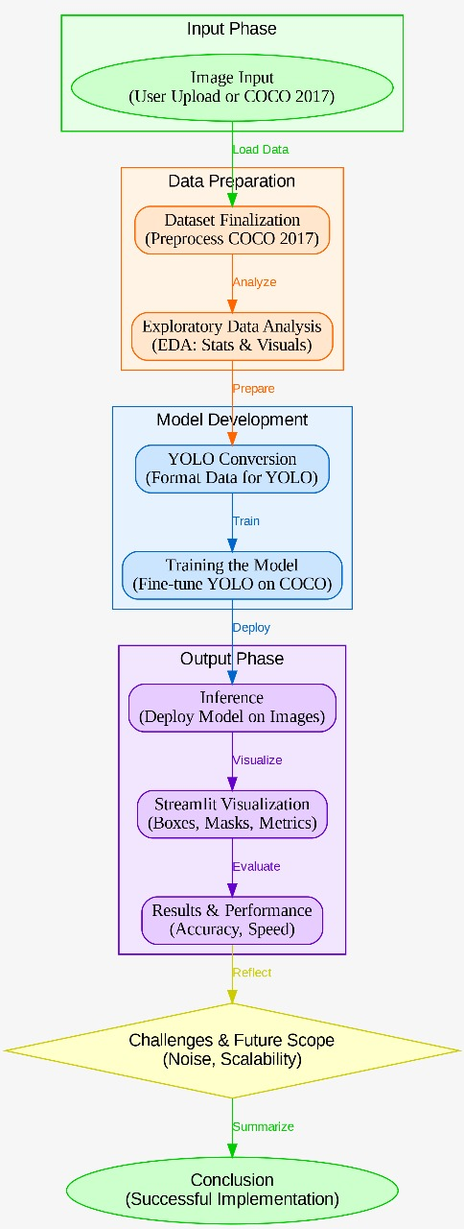
OVERVIEW DIAGRAM

Slide 6

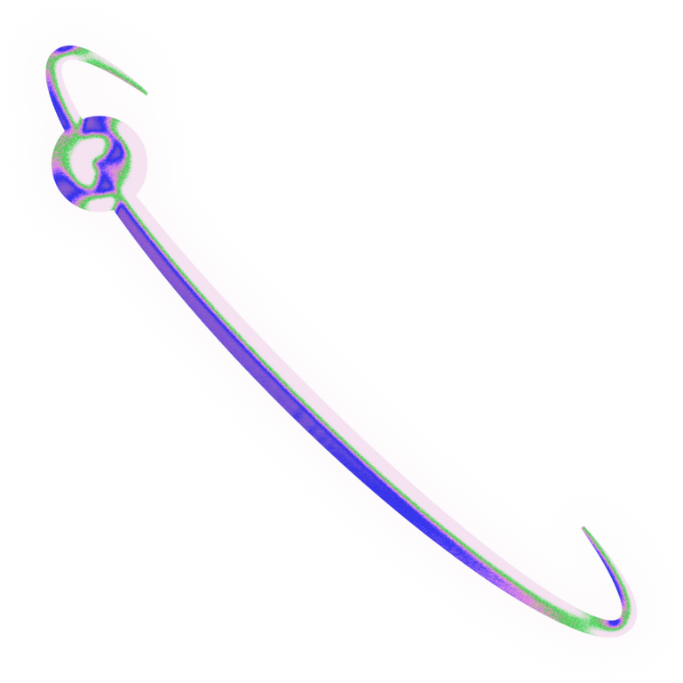
Dataset Chosen:
COCO 2017 (Subset) (Common Objects in Context).
Details: Taken a subset of COCO 2017 that contains 26k images with 80 categories. (Original Dataset Contains almost 118k images)
Why COCO?:Rich diversity of objects and scenes. Pre-annotated with bounding boxes and segmentation masks, ideal for YOLO.
Why Subset?: Due to the extensive size of the COCO dataset, a subset was created from it to optimize the computational efficiency, streamline processing and ensure faster training without compromising model performance
Finalization Process: Downloaded and verified dataset integrity.
Preprocessed images and annotations for compatibility with YOLO.
Benefits: Robust training base for real-world generalization. Supports multi-object scenarios and complex backgrounds
DATASET FINALIZATION

Slide 7

Dataset Integrity Check:
Verified missing image files and incomplete annotations to ensure data quality.
Image Size Distribution:
Analyzed width and height variations across the dataset.
Bounding Box Analysis:
Examined object sizes to understand scale and diversity.
Annotation Density:
Calculated annotations per image to assess image complexity for object detection.
Category Frequency Analysis:
Visualized object category distribution to identify class imbalances.
Preprocessing Insights:
Used findings to inform data augmentation strategies for better model learning
EXPLORATORY DATA ANALYSIS

Slide 8
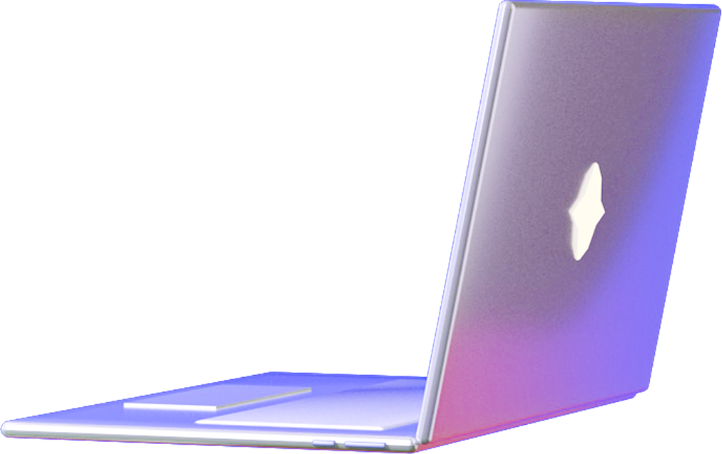
YOLO CONVERSION
Annotation Format Adaptation: Converted COCO 2017 subset annotations to YOLO-compatible format.
COCO JSON Structure: Extracted bounding box coordinates and category IDs from JSON-based COCO annotations.
YOLO Format Requirements: Transformed annotations into a text-based format with class IDs and normalized bounding box parameters.
Custom Conversion Function: Implemented a script to read COCO annotations, map category IDs, and compute normalized coordinates.
File Storage: Saved annotations as individual .txt files corresponding to each image.
Dataset Configuration: Created a data.yaml file specifying dataset paths and class names for YOLO training.
YOLO Training Readiness: Ensured the dataset was structured and fully compatible with the YOLO training framework
6AGE
07/15

Slide 9

TRAINING THE MODEL
Model Selection: Trained the YOLO model using the Ultralytics YOLOv8 framework.
Transfer Learning: Initialized YOLOv8 with pre-trained weights to enhance training efficiency and accuracy.
Dataset Configuration: Used the data.yaml file to define dataset paths for training, validation, and class labels.
Hyperparameter Tuning: Optimized parameters like batch size, learning rate, and epochs to improve performance.
Performance Monitoring: Tracked metrics such as training loss, validation loss, precision, recall, and mAP to ensure optimal learning and prevent overfitting.
Training Environment: Conducted training on a GPU-enabled setup to accelerate convergence.
Model Readiness: Successfully trained the YOLO model on the custom COCO2017 subset, preparing it for evaluation on unseen data.

Slide 10
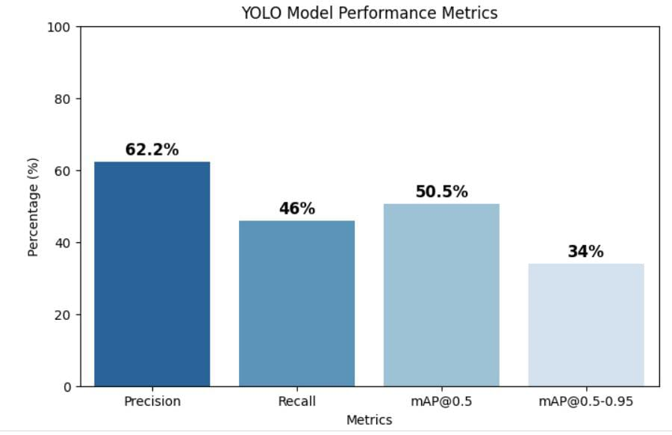
RESULTS AND PERFORMANCE METRICS
Precision: 62.2% → Measures how many detected objects are correct.
Recall: 46% → Measures how many actual objects were detected.
mAP@0.5: ~50.5% → Mean Average Precision at IoU=0.5 (moderate detection performance).
mAP@0.5-0.95: ~34% → Stricter IoU threshold, resulting in lower performance.

Slide 11
USER INTERFACE
Designed an interactive and user-friendly UI using Streamlit
Allows users to select the model type: Detection or Segmentation
Provides real-time visualization of input and detected objects
Includes detection controls like confidence threshold adjustment
Supports multiple input modes: Image, Video, and Webcam
Implements analytics and settings panel for advanced customization
Enables seamless file uploads with a drag-and-drop feature
Optimized for smooth and efficient user experience

Slide 12
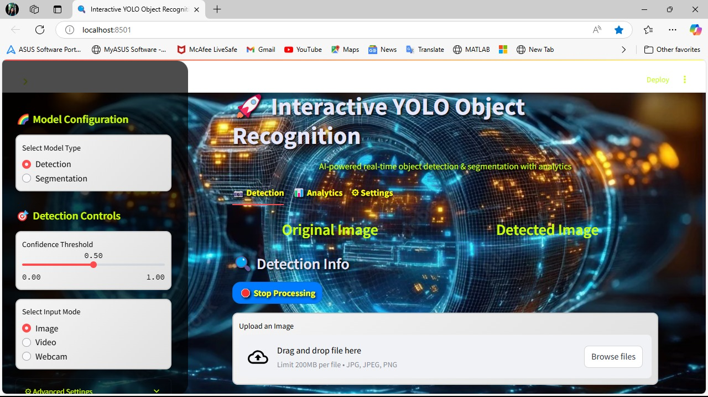

Slide 13

CHALLENGES
Dataset Complexity: Handling diverse object categories in the COCO 2017 dataset and ensuring annotation accuracy.
Model Performance Limitations: Precision (62.2%) and recall (46%) indicate scope for improvement, with a lower mAP@0.5-0.95 (~34%).
Real-Time Processing Challenges: High computational requirements for real-time inference, necessitating GPU acceleration.
Handling Occlusion & Small Objects: Difficulty in detecting objects in cluttered backgrounds, with performance drops for small or partially visible objects.
Generalization to Real-World Scenarios: Adapting the model to different lighting conditions, angles, and perspectives while preventing overfitting.

Slide 14
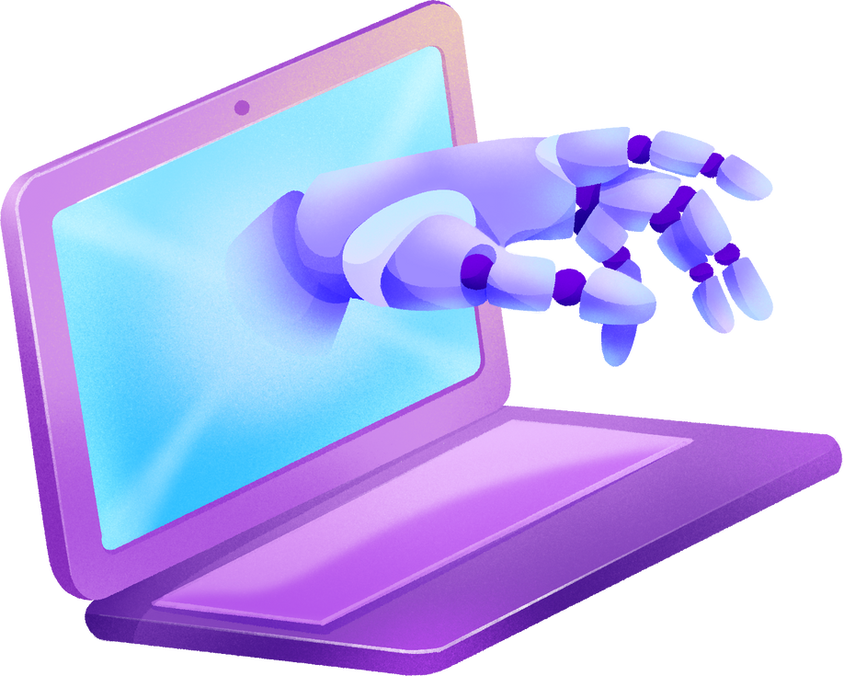
FUTURE DEVELOPMENTS
Model Optimization & Enhancement: Fine-tuning YOLO hyperparameters and exploring transformer-based detection models for improved accuracy.
Edge AI & Deployment in IoT: Optimizing the model for mobile and embedded devices, enabling real-time object detection in autonomous systems.
Integration with Augmented Reality (AR) & VR: Enhancing AR applications with real-time object recognition and extending object detection to immersive VR environments.
Multi-Modal Object Detection: Combining vision with audio and text for context-aware recognition and cross-domain applications like medical imaging.
Security & Surveillance Applications: Improving real-time monitoring for smart cities and AI-driven anomaly detection for threat prevention.

Slide 15

THANK YOU!

